Slide 1
TexGen Workshop
Dr Louise Brown
https://github.com/louisepb/PurdueWorkshop2019

Slide 2
Composites Research Group
University of Nottingham

Slide 3




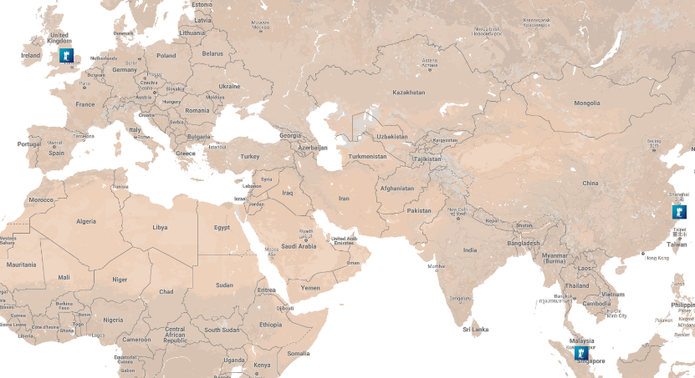

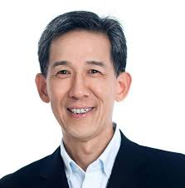





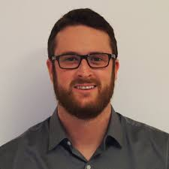










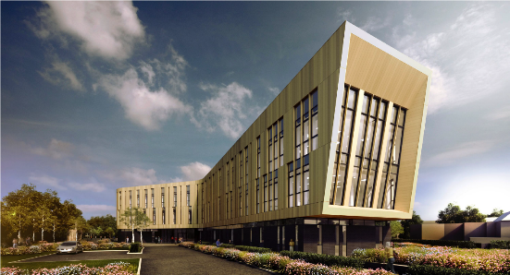

Composites Research Group Overview
Head of Group – Prof Nick Warrior
12 academics, including 5 professors
11 researchers
20 PhD/EngD students
Head of Group – Prof Xiaosu Yi
4 academics
4 Research Fellows
5 PhD students
Advanced Manufacturing Building
Jubilees Campus, Nottingham
Due Dec 2017
£24m investment
9000m² over 3 floors
600m² composites lab space
UK Research Portfolio (£14.5m)
EPSRC Future Composites Manufacturing Hub - £10.3m *
Other EPSRC - £265k
Innovate UK - £810k
Industry - £1.5m
European Commission - £1.1m
Other - £500k
(* Includes funding for other Hub members)
Head of Group – Dr Albert Tshai
4 academics
5 PhD students

Slide 4
UoN Research Portfolio
AVIC – Nottingham University Innovation Centre
Buckling analysis software of stiffened panel structures
Impact damage in composite components
Design and strength analysis of braided composites
Biaxial material testing
Tack testing of prepregs and ATL tapes
SAFE-FLY EID
Composites Manufacturing
Mechanical and Failure
Textile Composites
Bio-composites
Composites Recycling
Processing and performance of polymer matrix composites
Interests in both thermoset and thermoplastic matrices
Emerging interests in novel metal materials and hybrid structures
EPSRC Future Composites Manufacturing Hub – Automated Dry Fibre Placement
Advanced Manufacturing Supply Chain Initiative (AMSCI) – ProPound
Composites Innovation Cluster (CiC)
Affordable Lightweighting Through Pre-Form Automation (ALPA)
Thermoplastic Overmoulding for Structural Composite Automotive Applications (TOSCAA)
EPSRC Future Composites Manufacturing Hub – Textile Optimisation
EPSRC RSE Fellowship – Texgen
Damage Modelling of Composites (Variability in Textiles)
Friction in composites forming
BAM – Breakthrough Aerospace Material
Bioresorbable Engineering Nanocomposites for Healthcare (BENcH)
In situ polymerization of bioresorbable composites
Resorbable fibre textile manufacture
Production of commercially scalable multifilament phosphate fibre tows
Boeing – Nottingham Strategic Collaboration
Towards Affordable, Closed-Loop Recyclable Future Low Carbon Vehicle Structures (TARF-LCV)
Markets for fluidized bed carbon fibre recycling
Graphene-based Electrodes for Application in Supercapacitors (ElectroGraph)

Slide 5
General Overview of the TexGen Project

Slide 6
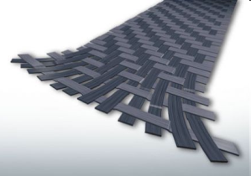
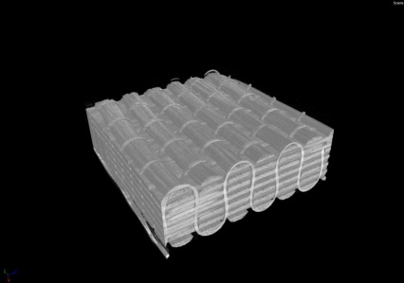
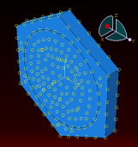
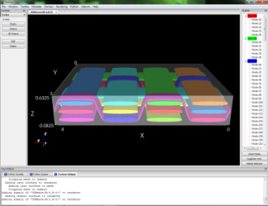
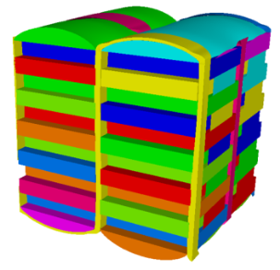
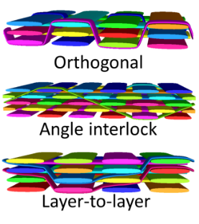
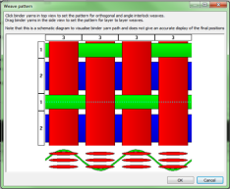

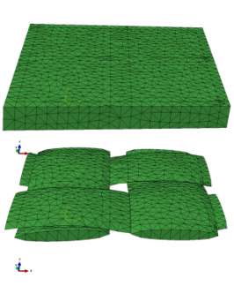
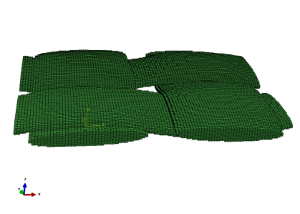
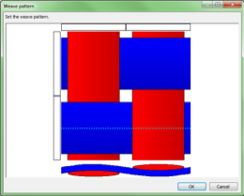
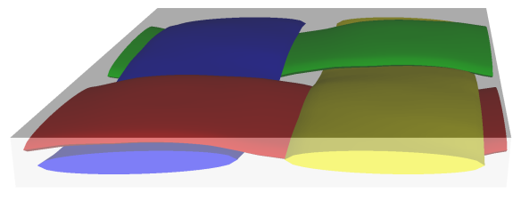
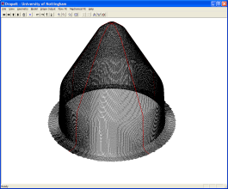
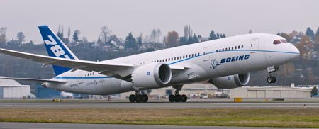
TexGen Geometric Textile Modelling Software
Fibre/Micro-Scale
Micro-scale FEA simulations or analytical methods determine yarn properties
Unit Cell/Meso-Scale
Generate textile geometry using TexGen GUI or script
3D wizard generates idealised 3D textiles
Refinement of orthogonal weave to simulate compaction
Automatically generate 2D and 2D sheared textiles
Generate mesh and input files for FEA or CFD to predict material properties
Composite material properties extracted from meso-scale predictions are used to model structural components
Component/Macro-Scale

Slide 7
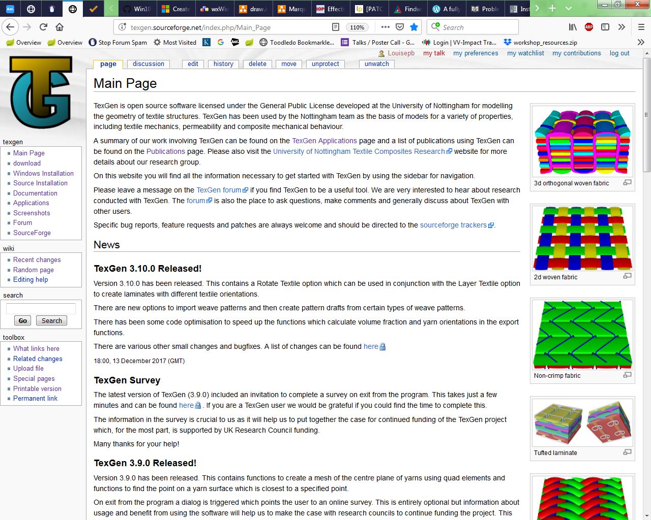
TexGen Webpage
www.texgen.sourceforge.net

Slide 8
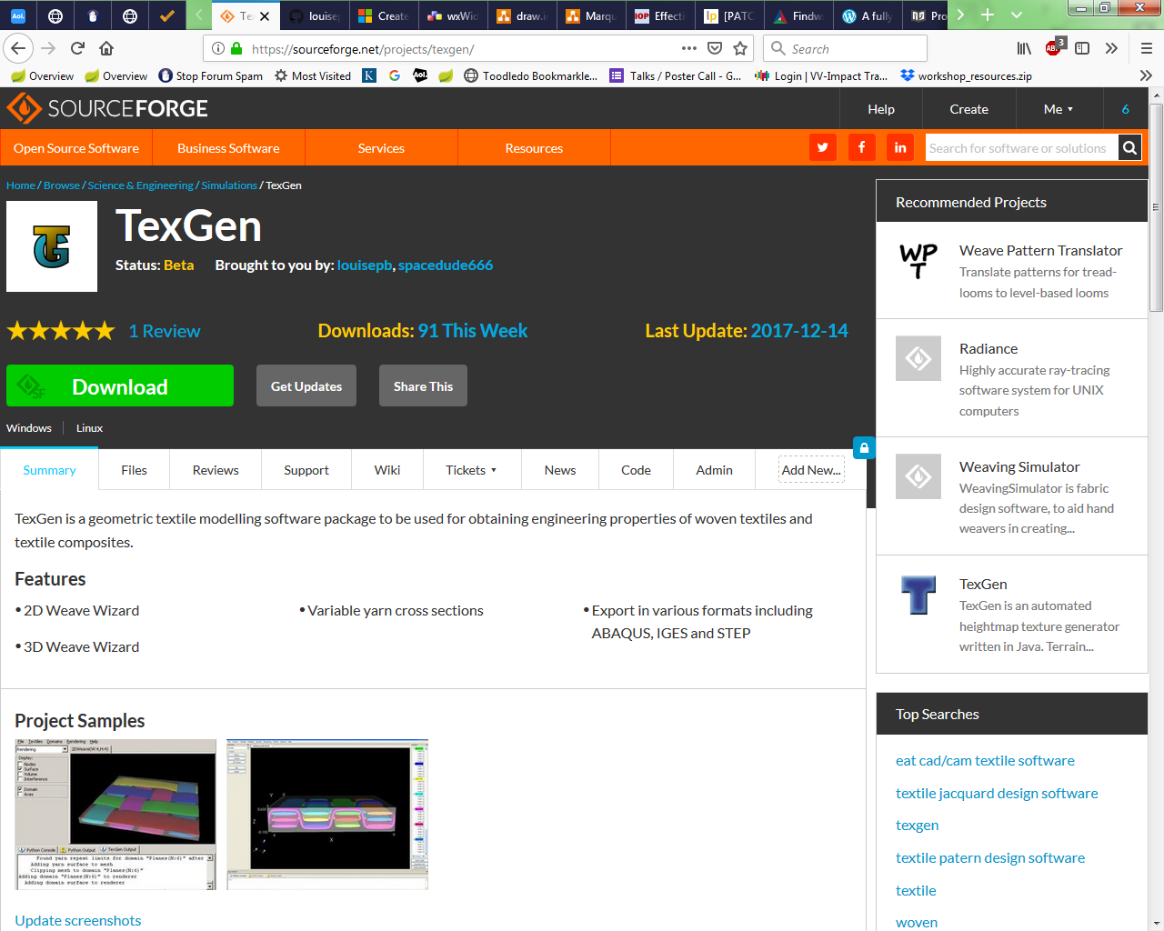
Download TexGen
https://sourceforge.net/projects/texgen/
Use the Files tab to access different versions and installation files with and without bundled Python

Slide 9
Code on GitHub
Source code is stored on GitHub
https://github.com/louisepb/TexGen
Instructions for compiling from source for both Windows and Linux are here:
http://texgen.sourceforge.net/index.php/Compiling_from_Source
Bugs/issues can be reported here:
https://github.com/louisepb/TexGen/issues
Sample scripts are here:
https://github.com/louisepb/TexGenScripts

Slide 10
TexGen Forum
Queries about TexGen can be directed via the TexGen forum
http://texgen.sourceforge.net/phpBB3/index.php
This is also a useful source of information and gives a record of queries and discussion by other TexGen users

Slide 11
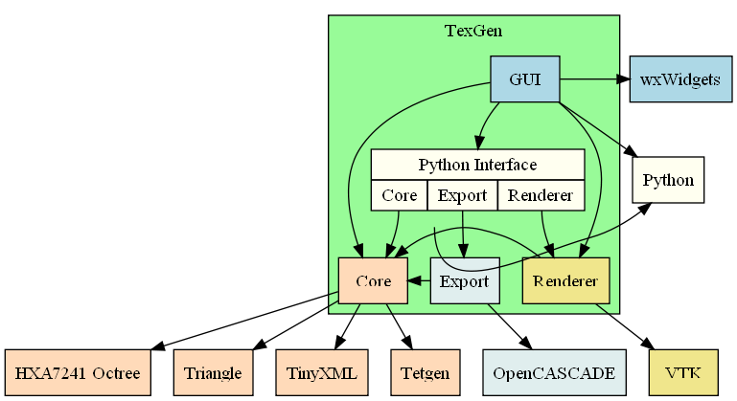
Implementation
Modular - Core functionality is in the core module, graphics are in a renderer module; if not using visualisation, the renderer doesn’t need to be built.
Flexible – Can be used with the GUI, using SWIG generated Python code or used as a library of C++ functions
Platform independent – Can be run on most operating systems supported by the Cmake build system.

Slide 12
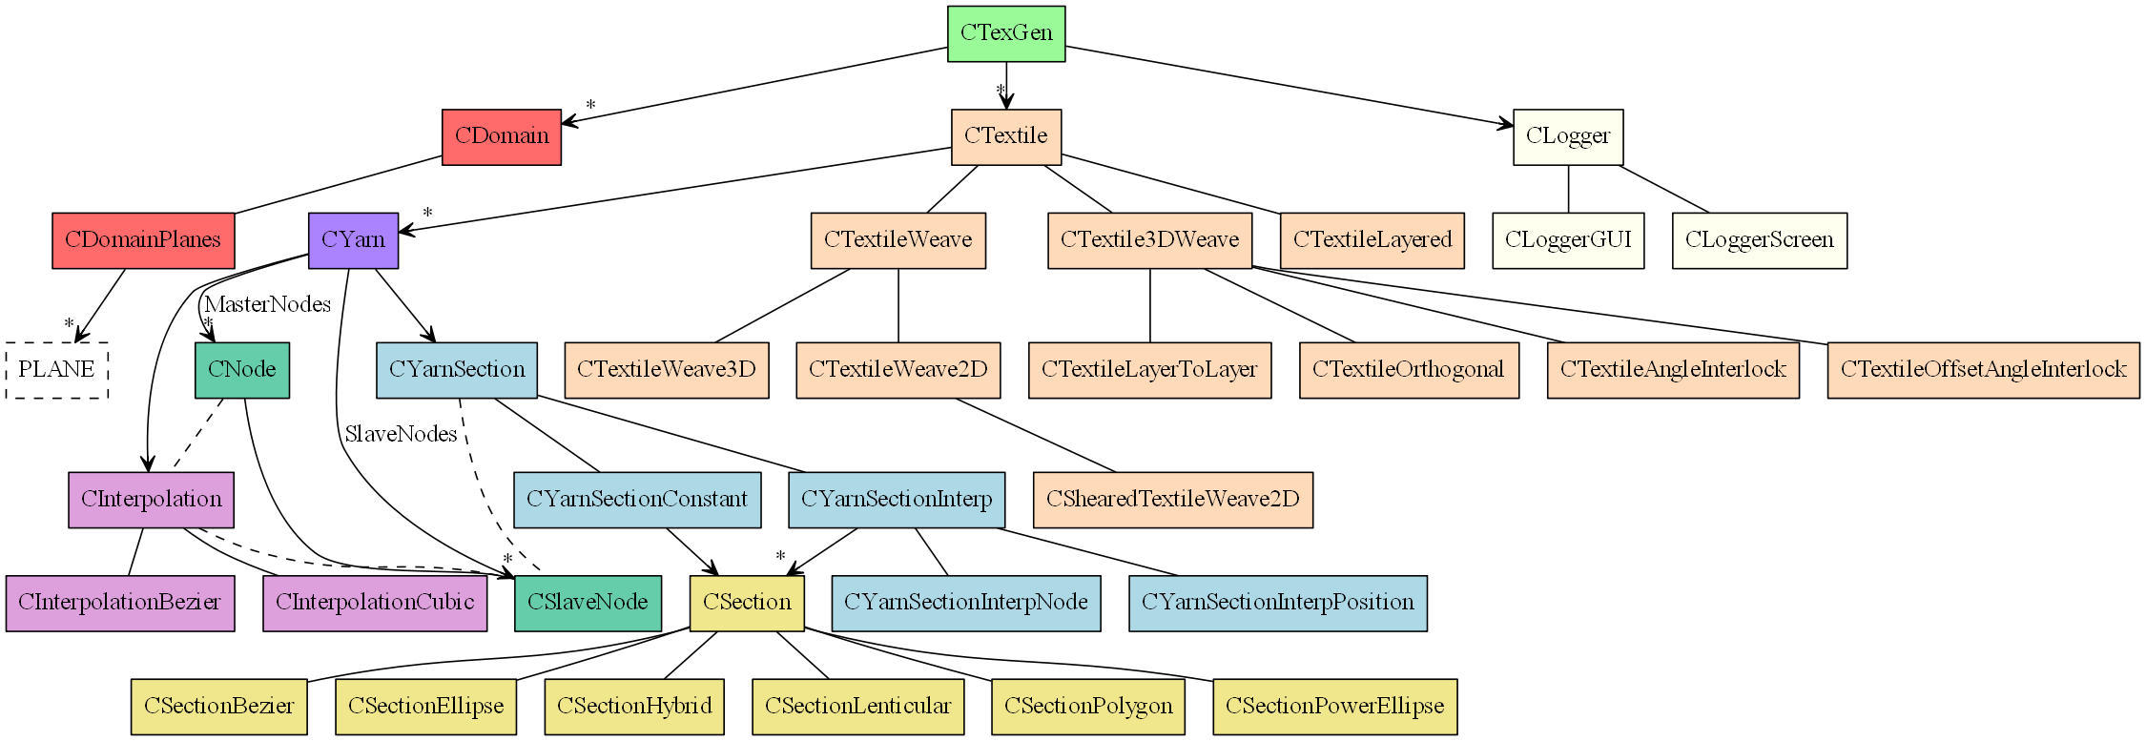
TexGen Class Hierarchy

Slide 13
TexGen Use Cases

Slide 14
Permeability and Mechanical Modelling

Slide 15
Advanced Geometry Modelling of 3D Woven Reinforcements in Polymer Composites: Processing and Performance Analysis
X. Zeng, L.P. Brown, A. Endruweit, A.C. Long
X Zeng, L P Brown, A Endruweit, A C Long. “Advanced geometry modeling for 3D woven fabrics in composites processing and performance analysis”, Proc. 4th World Conf. on 3D Fabrics & their Applications, Aachen, Germany, Sept 2012.

Slide 16
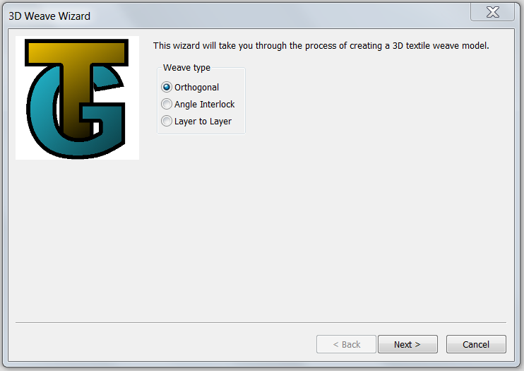
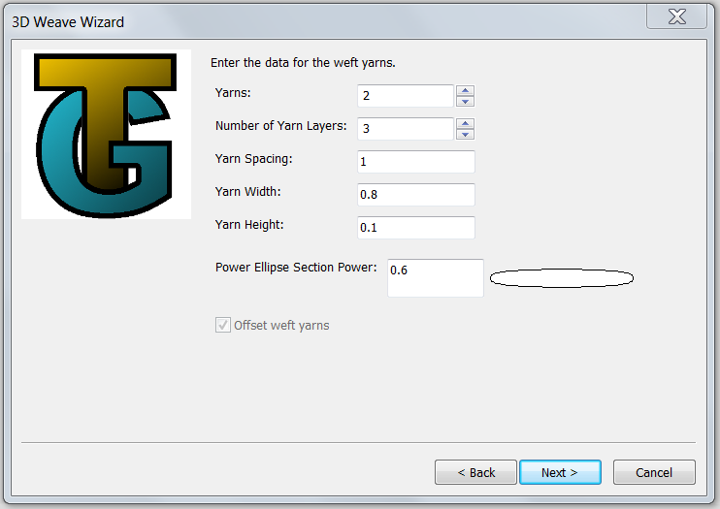

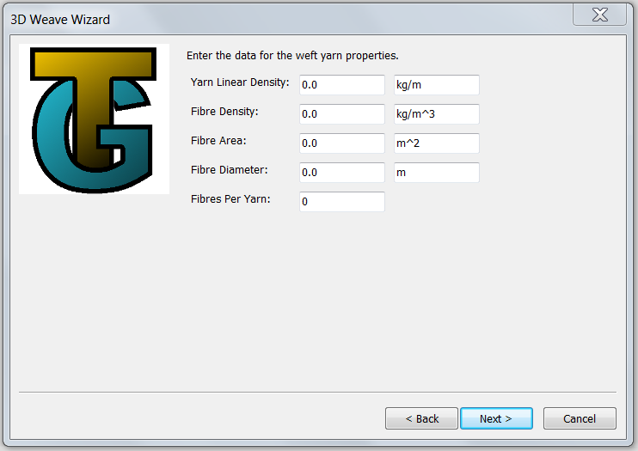
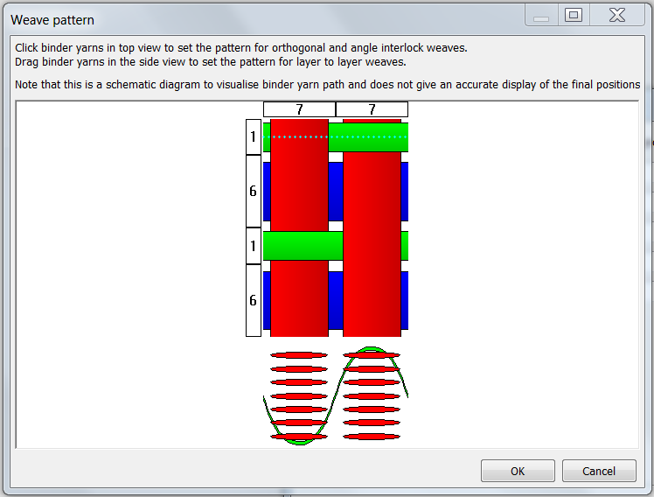
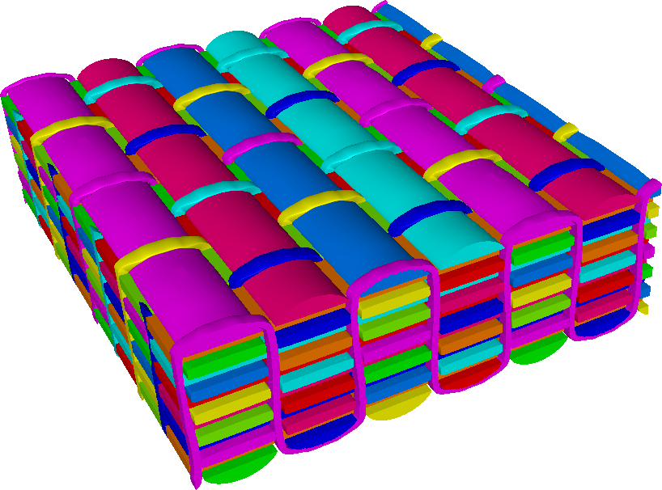
Geometrical modelling
acquisition of detailed geometry data (μ-CT scanning)
Example:
orthogonal carbon fibre weave
Fabric style | Orthogonal weave
Areal density (kg/m²) | 4.775
Number of warp layers | 6
Warp yarn | 12K
Warp yarn linear density (g/km) | 800
Number of weft layers | 7
Weft yarn | 6K × 2
Weft yarn linear density (g/km) | 800
Binder yarn | 1K
Binder yarn linear density (g/km) | 67
generation of geometrical model in TexGen

Slide 17
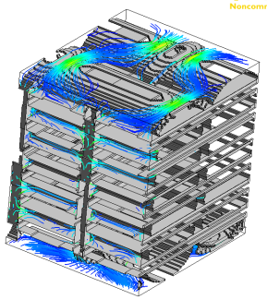
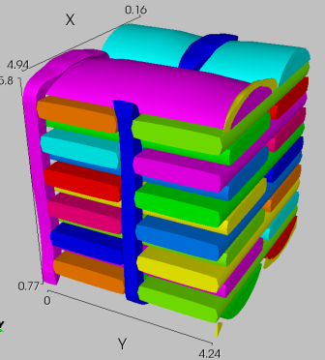
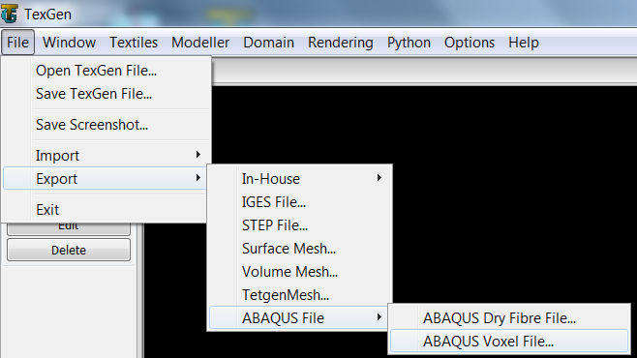
Fabric permeability
Impregnating resin flow in composites processing is described by homogenisation of local flow through pore spaces in the textile unit cell
TexGen unit cell model
CFD simulation of steady-state Stokes flow
(Ansys CFX)
generation of voxel mesh
(streamlines for flow along warp direction)
Determine in-plane and through-thickness permeabilities from prescribed pressure gradients and calculated average flow velocities

Slide 18
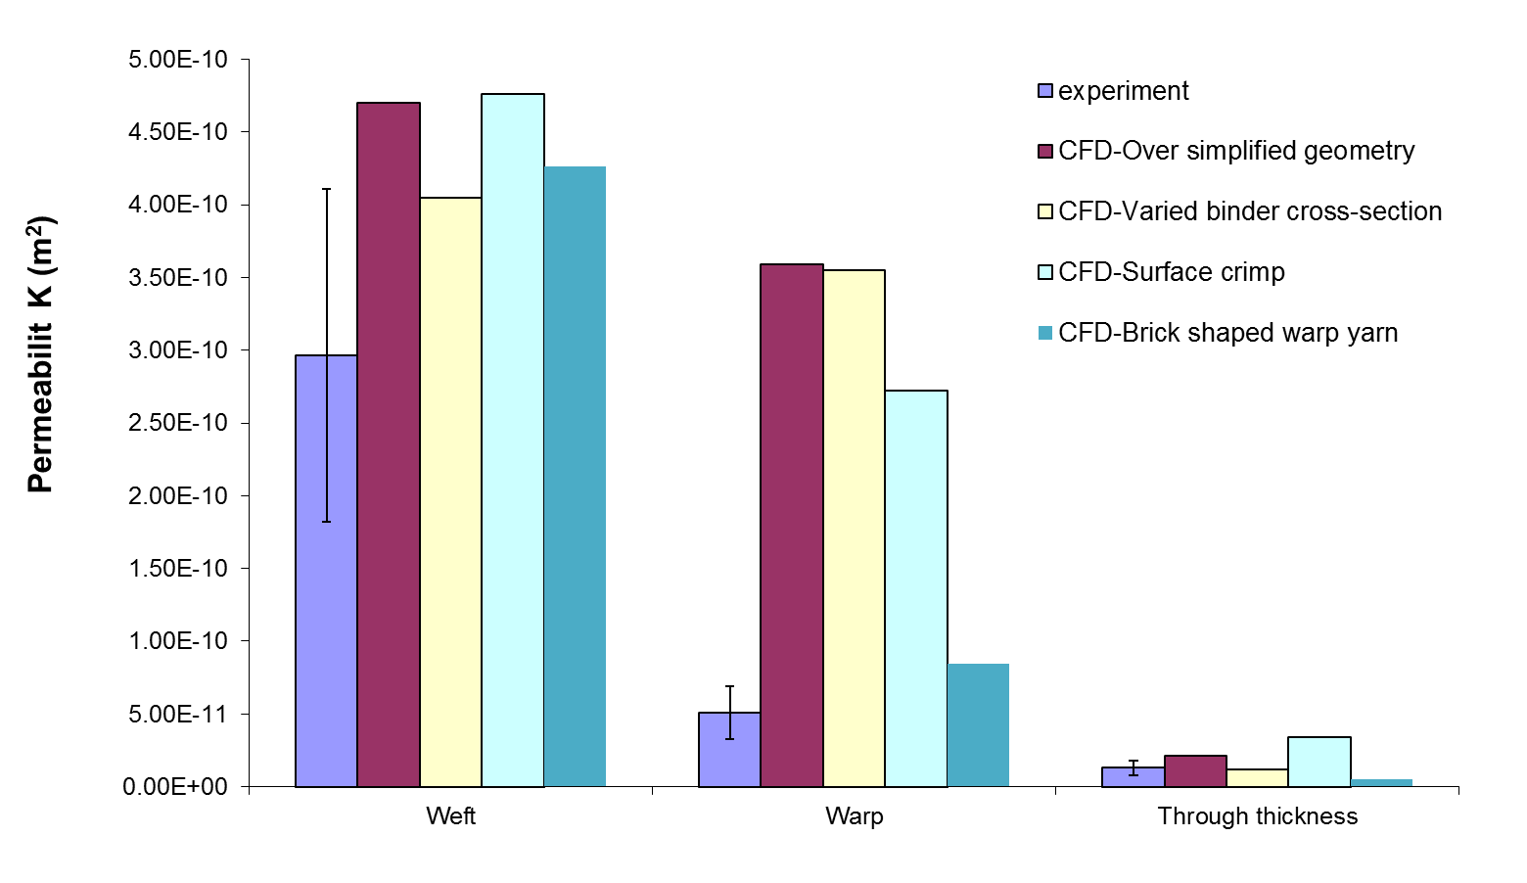
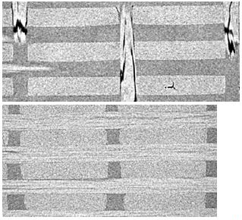
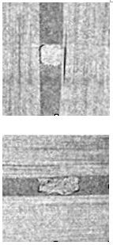
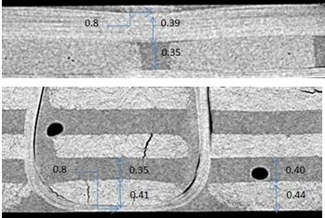
Geometry refinement
Increasingly accurate modelling of yarn geometries
Experimental permeability data
Simulation with straight yarns, constant elliptical cross-section
Varying binder cross-section, weft and warp yarns straight, constant cross-section
Deformation of weft yarns on fabric surface
Yarn cross-sections ‘more rectangular’ in warp direction than in weft direction

Slide 19
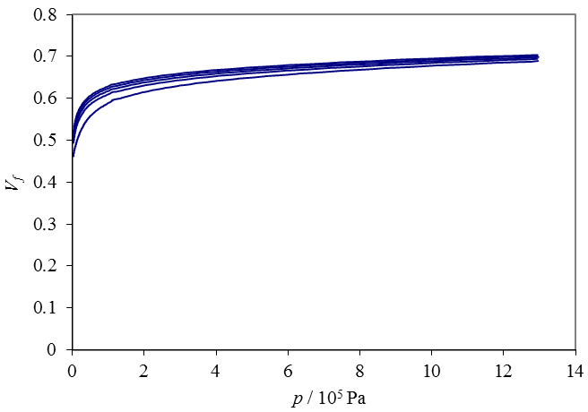
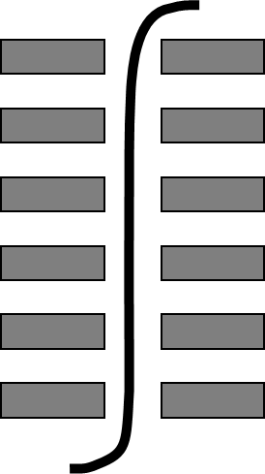
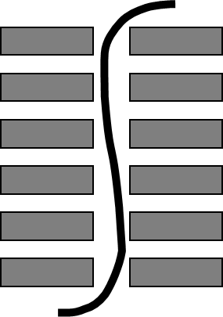
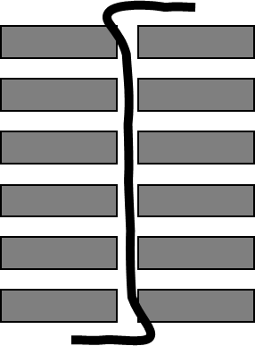
Compression modelling
cycle 5
cycle 1
Quasi-static compression (5 mm/min) between flat parallel plates,
1 fabric layer
3.94 mm
5.88 mm
binder “buckling”
yarn flattening, widening

Slide 20
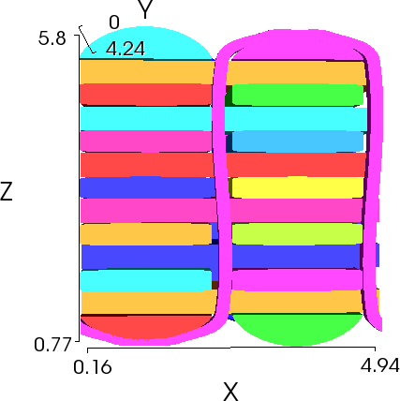
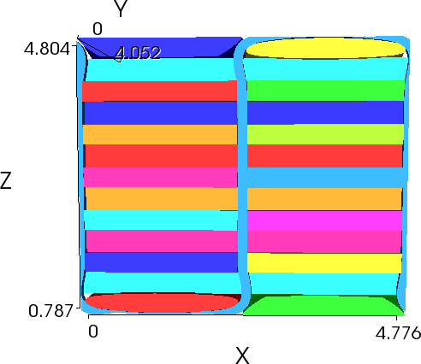
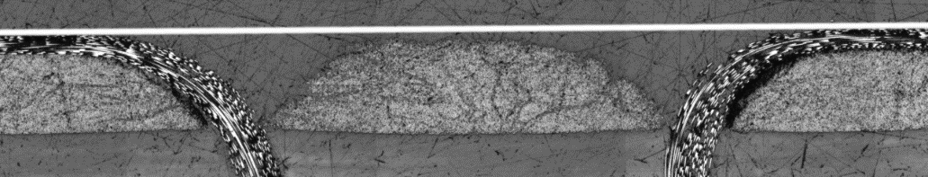
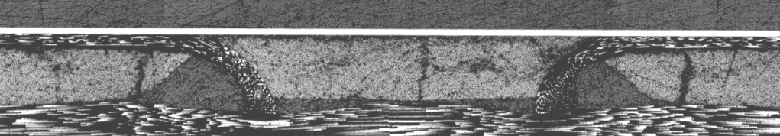
Compression modelling
Geometry modelling of fabric at different compaction levels
details of complex deformation difficult to reproduce accurately !
Vf = 0.55
Vf = 0.67
Experimental geometry analysis: top layer of weft yarns on fabric surface
Vf = 0.55, h = 5 mm
Vf = 0.65, h = 4.2 mm

Slide 21
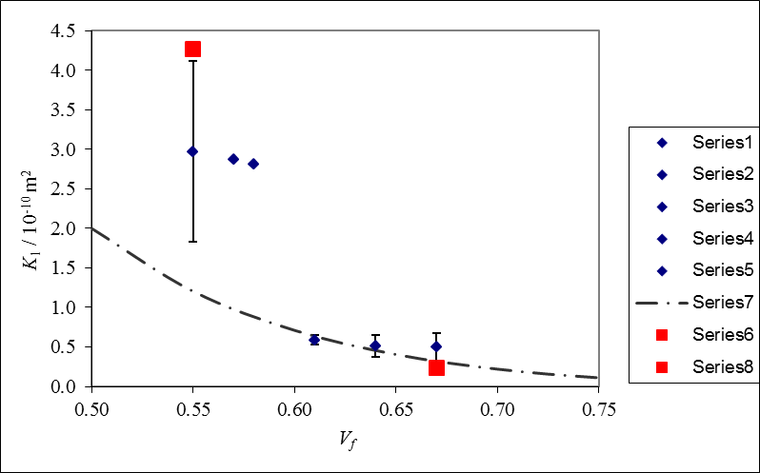
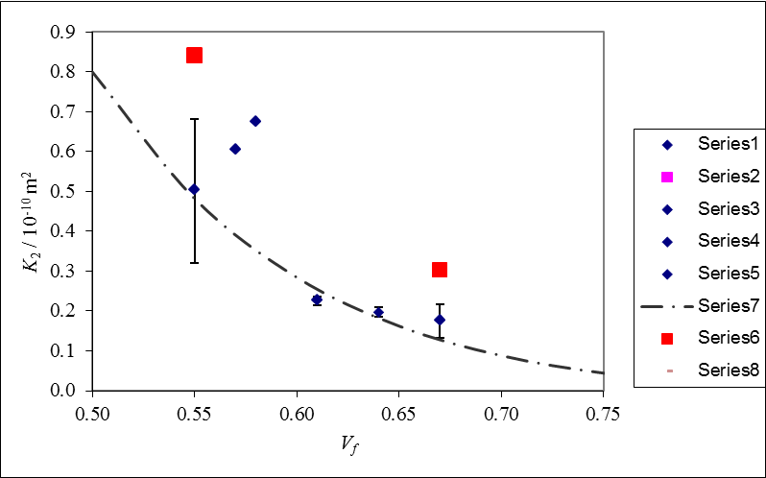
Compressed permeability
top layer of weft yarns on fabric surface
Vf = 0.55
experiment
CFD
experiment
CFD
(permeability along weft-direction)
(permeability along warp-direction)
Kozeny-Carman fit
Kozeny-Carman fit
Vf = 0.65
Discontinuity in K₁ is related to change in binder configuration on fabric surface;
not described by analytical permeability models, requires numerical analysis

Slide 22
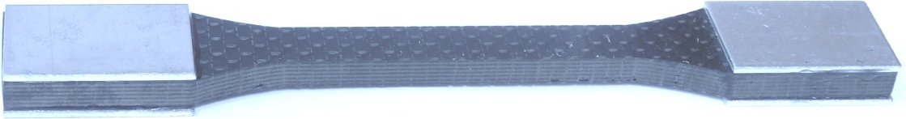
Composite mechanical properties
Moulding of composite plaques by vacuum-driven RTM:
1 fabric layer
Gurit PRIME 20LV epoxy infusion system
Tensile testing according to
European Standard EN ISO 527-4:1997
h = 5 mm, Vf = 0.55
composite was tested in warp- and weft-direction
Nominal material data for numerical analysis
 | E / GPa | Tensile strength / MPa | Tensile failure strain / % | Interlaminar shear strength / MPa
Cured resin | 3.5 | 73 | 3.5 | 47
Fibre: Toray T300 | 230 | 3450 | 1.5 | -

Slide 23
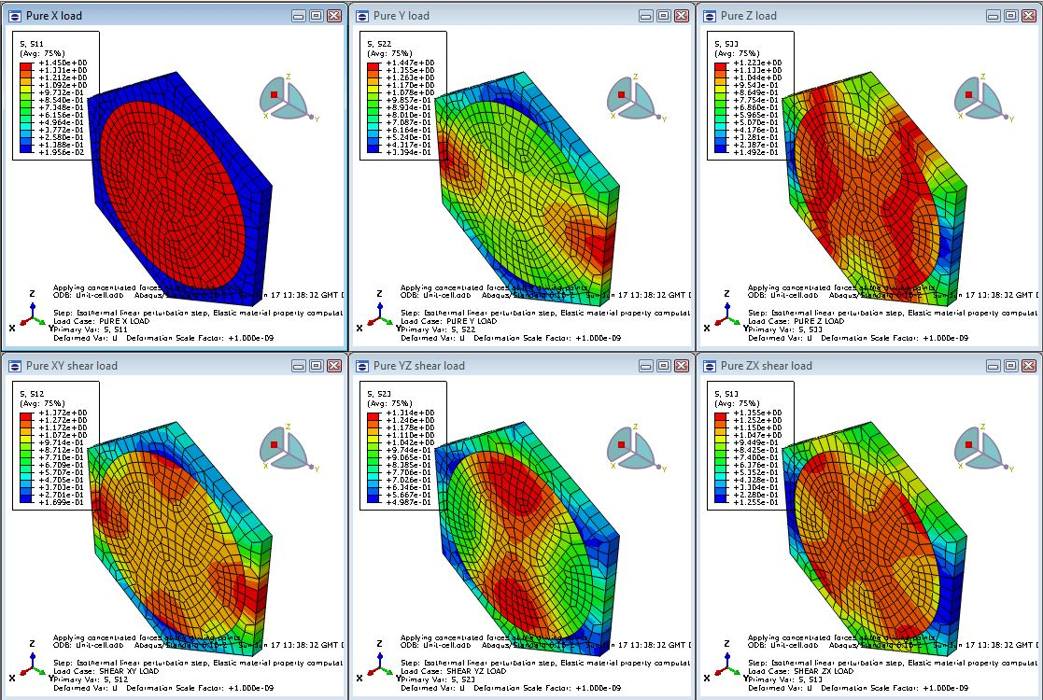
Yarn mechanical analysis
Finite element analysis for calculation of elastic properties for composite (impregnated yarns), assuming hexagonal packing of filaments:
six load cases of a single filament (+ resin) unit cell model
E11
E22
E33
(ABAQUS)
G12
G23
G13
alternative: micromechanics equations (Chamis)

Slide 24
Yarn mechanical analysis
Properties of impregnated yarn, derived from FE analysis, fibre Torayca T300
V_{f} = 0.66 in yarn, corresponding to V_{f} = 0.55 in unit cell
E₁₁ | E₂₂, E₃₃ | G₁₂, G₁₃ | G₂₃ | ν₁₂, ν₁₃ | ν₂₃ | F₁₁ | F₂₂ | F₁₂
152.6 GPa | 8.15 GPa | 3.02 GPa | 2.9 GPa | 0.3 | 0.345 | 2289 MPa | 69.6 MPa | 47 MPa
from fibre failure strain
resin tensile strength
ILSS
Failure model (Ruijter):
longitudinal: brittle failure (fibres)
longitudinal:
maximum stress
transverse, shear:
gradual stiffness reduction (matrix)
shear:
partial distortion energy
c1 = 8, c2 = 13
(empirical)
transverse:
maximum principal stress
Ruijter, W., Analysis of mechanical properties of woven textile composite as functions of textile geometry, PhD dissertation, University of Nottingham, 2008

Slide 25
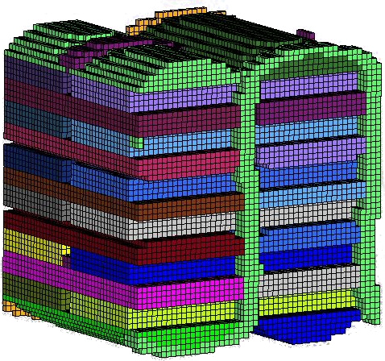
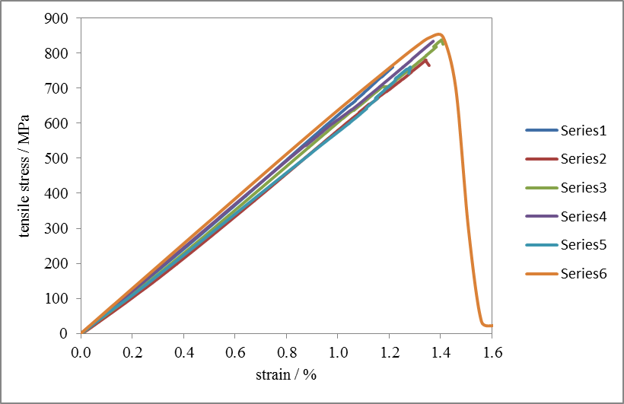
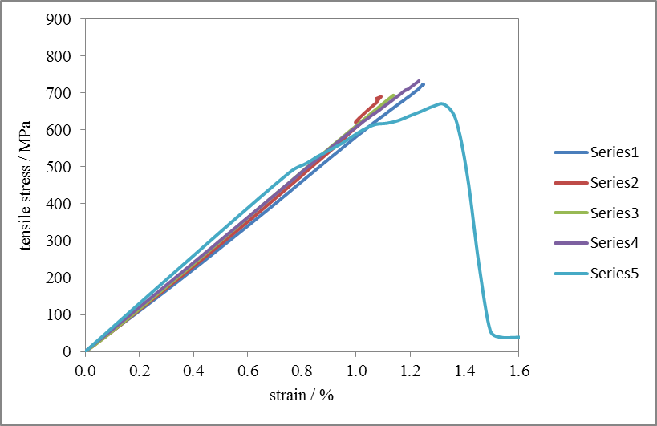
Unit cell mechanical analysis
Assignment of local properties + orientations to TexGen voxel mesh of composite unit cell for mechanical FE analysis
 | warp |  | weft
 | F / MPa | E / GPa | F / MPa | E / GPa
simulation | 845 | 64 | 669 | 64
experiment | 791 ± 38 | 60 ± 2 | 710 ± 21 | 58 ± 3
voxels representing resin only are not shown
warp-direction
weft-direction
experiments
(5 repeats)
experiments
(4 repeats)
simulation
simulation

Slide 26
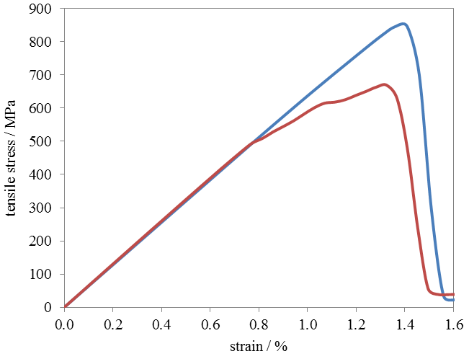
Unit cell mechanical analysis
Comparison of calculated properties in warp- and weft-direction
failure strain similar in both directions
warp
predicted failure of crimped surface layers
difference in strength is related to ratio of fibre volume in both directions, if surface layers are discounted
weft
crimped surface layers in weft-direction contribute little to strength

Slide 27
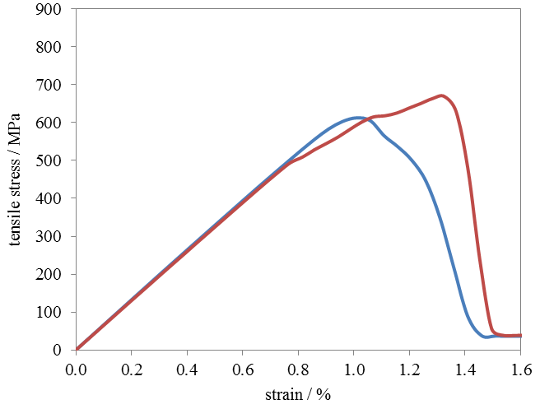


Unit cell mechanical analysis
Influence of voxel mesh density,
for weft yarns only
fine
coarse
significant difference in failure strain
artefacts in geometry meshing affect simulation results

Slide 28
Conclusions
For a 3D orthogonal weave, the architecture was characterised in detail by analysis of μ-CT images of composites.
Geometrical unit cell models were generated in TexGen in a semi-automated manner.
Fabric permeability predictions based on simulations of impregnating flow
improved significantly in accuracy with increasing level of detail in geometrical modelling
indicated that binder configuration on fabric surface has significant effect on weft permeability
Composite strength predictions based on static mechanical analyses
showed good quantitative agreement with experimental results
indicated reduced strength in weft-direction, mainly due to crimp in surface layers

Slide 29
Acknowledgement
This work was supported by the Engineering and Physical Sciences Research Council [grant number: EP/IO33513/1], through the EPSRC Centre for Innovative Manufacturing in Composites.
3D woven fabric was supplied by Airbus UK.

Slide 30
Coefficient of Thermal Expansion

Slide 31
Predicting the Coefficient of Thermal Expansion for Textile Composites Based on a Unit Cell Approach
Louise P. Brown, Xuesen Zeng, Andrew C. Long, Richard Brooks, I. Arthur Jones
L P Brown, X Zeng, A C Long, R Brooks, I A Jones. “Predicting the coefficient of expansion for textile composites based on a unit cell approach”, Proc. 11th Int. Conf. on Textile Composites (TexComp-11), Leuven, Sept 2013.

Slide 32



Objectives
To predict coefficients of thermal expansion (CTEs) for sheared woven fabric laminates, which have been characterised through experiments.
To improve the quality of prediction by automated creation of realistic geometries in TexGen
Sources of shear deformation
Fabric forming
Manufacturing defects caused by material handling

Slide 33




Sheared Textile Modelling
Extension to existing 2D weave wizard
Input shear angle
Optional sheared domain
Max intersection depth = 0.034mm

Slide 34




Sheared Yarn Rotation Angle
Calculation of rotational angle at yarn crossover to avoid intersections

Slide 35


Cross-section adjustment
Intersection correction
Algorithm already implemented for non-sheared 2D weaves
Creates polygon cross-sections
Results in loss of yarn volume
Cross section adjustment
Tow drop offset
Modifier = 1: Cross-section point is on domain plane
Modifier < 1: Intersection with plane lies inside yarn volume. Modifier applied. Iterative method used to adjust cross-section points to restore original cross-sectional area
Modifier > 1: Shown in figure. No adjustment required

Slide 36




Refined Sheared Textile
Unrefined, 15°
Refined, 15 °
Max intersection depth = 0.034mm
Max intersection depth = 0.0015mm

Slide 37



CTE Prediction of Sheared Laminates
Abaqus input file is generated automatically within the TexGen GUI
Compatible voxelised mesh is created with periodic boundary conditions

Slide 38





Shear domain periodic boundary conditions
Face A & B relative displacement
$$\begin{matrix}{\left.−u\right|}_{B}{\left.+u\right|}_{A}{−S}_{2}ε_{x}^{0}=0 \\ {\left.−v\right|}_{B}{\left.+v\right|}_{A}=0 \\ {\left.−w\right|}_{B}{\left.+w\right|}_{A}=0\end{matrix}$$
Face C and D:
$$\begin{matrix}{\left.−u\right|}_{D}{\left.+u\right|}_{C}{−S}_{1}{(ε}_{x}^{0}\sin{β}+γ_{xy}^{0}\cos{β)}=0 \\ {\left.−v\right|}_{D}{\left.+v\right|}_{C}{−S}_{1}ε_{y}^{0}\cos{β}=0 \\ {\left.−w\right|}_{D}{\left.+w\right|}_{C}=0\end{matrix}$$
Faces E and F orthogonal to Z (Thickness C)
$$\begin{matrix}{\left.−u\right|}_{E}{\left.+u\right|}_{F}−Cγ_{xz}^{0}=0 \\ {\left.−v\right|}_{E}{\left.+v\right|}_{F}−Cγ_{yz}^{0}=0 \\ {\left.−w\right|}_{E}{\left.+w\right|}_{F}−Cε_{z}^{0}=0\end{matrix}$$
y
Edges: $\begin{matrix}{\overset{⃑}{U}}_{2}−{\overset{⃑}{U}}_{1}=F_{AB} \\ {\overset{⃑}{U}}_{4}−{\overset{⃑}{U}}_{1}=F_{CD} \\ {\overset{⃑}{U}}_{3}−{\overset{⃑}{U}}_{1}=F_{AB}+F_{CD}\end{matrix}$
$$\begin{matrix}{\overset{⃑}{U}}_{6}−{\overset{⃑}{U}}_{5}=F_{AB} \\ {\overset{⃑}{U}}_{8}−{\overset{⃑}{U}}_{5}=F_{EF} \\ {\overset{⃑}{U}}_{7}−{\overset{⃑}{U}}_{5}=F_{AB}+F_{EF}\end{matrix}$$
$$\begin{matrix}{\overset{⃑}{U}}_{10}−{\overset{⃑}{U}}_{9}=F_{CD} \\ {\overset{⃑}{U}}_{12}−{\overset{⃑}{U}}_{9}=F_{EF} \\ {\overset{⃑}{U}}_{11}−{\overset{⃑}{U}}_{9}=F_{CD}+F_{EF}\end{matrix}$$
Vertices:
$$\begin{matrix}{\overset{⃑}{U}}_{N2}−{\overset{⃑}{U}}_{N1}=F_{AB} \\ {\overset{⃑}{U}}_{N4}−{\overset{⃑}{U}}_{N1}=F_{CD} \\ {\overset{⃑}{U}}_{N3}−{\overset{⃑}{U}}_{N1}=F_{AB}+F_{CD}\end{matrix}$$
$$\begin{matrix}{\overset{⃑}{U}}_{N5}−{\overset{⃑}{U}}_{N1}=F_{EF} \\ {\overset{⃑}{U}}_{N6}−{\overset{⃑}{U}}_{N1}=F_{EF}+F_{AB} \\ {\overset{⃑}{U}}_{N7}−{\overset{⃑}{U}}_{N1}=F_{AB}+F_{EF}+F_{CD}\end{matrix}$$
$$\begin{matrix}{\overset{⃑}{U}}_{N8}−{\overset{⃑}{U}}_{N1}=F_{CD}{+F}_{EF} \\ \\ \end{matrix}$$
Node 8 (4)
Edge 11(10)
Face C
$${\vec{S}}_{2}$$
Edge 4
Node 7 (3)
Edge 3
Face B
Shear angle
β
Face A
Edge 8(5)
Face E (F)
Edge 7(6)
$${\vec{S}}_{1}$$
Edge 1
Node 5 (1)
Face D
Edge 2
x
Edge 12(9)
Node 6 (2)
Li, S., C.V. Singh, and R. Talreja, A representative volume element based on translational symmetries for FE analysis of cracked laminates with two arrays of cracks. International Journal of Solids and Structures, 2009. 46(7–8): p. 1793-1804.

Slide 39





Thermal mechanical analysis
$$α=\left[\begin{matrix}α_{xx} & a_{xy} & a_{xz} \\ & α_{yy} & a_{yz} \\ & & α_{zz}\end{matrix}\right]$$
CTEs are recovered directly from unit cell strain tensor:
$$\begin{matrix}\begin{matrix}α_{xx}=ε_{x} \\ α_{yy}=ε_{y} \\ α_{zz}=ε_{z}\end{matrix} \\ \begin{matrix}α_{xy}=γ_{xy} \\ α_{xz}=γ_{xz} \\ α_{yz}=γ_{yz}\end{matrix}\end{matrix}$$
ABAQUS static analysis, perturbation
_{Temperature change} $∆T=$₁º_{C}

Slide 40
Validation case study
Material:
Plain weave, CF0504, (3K HTA 5131 carbon fibres, 200 gsm, 5 ends per cm)
10-ply laminates, created by resin film stacking :
(1) un-sheared (V_{f} =47.5%), (2) sheared at 16 degrees & (3) 20 degrees
Consolidation:
Autoclave at pressure of 6 bar
5 hours initial cure at 80°C
Ramp rate 2°C/min
After cooling below 60°C and release of pressure, free standing post-cure for 1 hour at 120°C
Yarn width | Yarn height | Yarn in-plane spacing | Laminate thickness
1.76mm | 0.16mm | 2.03mm | 2.4mm
Matrix:
MTM46 from CYTEC (previously ACG or UMECO
Hobbiebrunken, T., M. Hojo, K.K. Jin, and S.K. Ha, Influence of non-uniform fiber arrangement on microscopic stress and failure initiation in thermally and transversely loaded CF/epoxy laminated composites. Composites Science and Technology, 2008. 68(15–16): p. 3107-3113.
Fiedler, B., M. Hojo, S. Ochiai, K. Schulte, and M. Ochi, Finite-element modeling of initial matrix failure in CFRP under static transverse tensile load. Composites Science and Technology, 2001. 61(1): p. 95-105.
Pradere, C. and C. Sauder, Transverse and longitudinal coefficient of thermal expansion of carbon fibers at high temperatures (300–2500&#xa0;K). Carbon, 2008. 46(14): p. 1874-1884.
Fibre properties
E₁₁ =235GPa, E₂₂ = E₃₃ =15GPa, v₁₂ =0.3, v₂₃ =0.3, G₁₂=15, a_{L} = -0.4x10⁻⁶/K,
a_{T} = 10x10⁻⁶/K
Matrix properties
E=2.7GPa
v=0.4
a = 40x10⁻⁶ /K after the full thermal cycle

Slide 41


Thermal expansion measurement
Table of CTEs (x10⁻⁶/K)
Samples
Table of sample cut angle θ (degree)
Shear 0º |  | Shear 16º |  | Shear 20º
θ | CTE | θ | CTE | θ | CTE
0 | 2.12 | 0 | 2.36 | 0 | 2.99
45 | 2.32 | 37 | -6.23 | 15 | 0.25
90 | 2.02 | 74 | 3.93 | 30 | -3.3
 |  | 127 | 23.1 | 45 | -3.23
 |  |  |  | 60 | -0.97
 |  |  |  | 75 | 3.82
 |  |  |  | 90 | 8.46
 |  |  |  | 105 | 14.35
 |  |  |  | 120 | 18.49
 |  |  |  | 135 | 15.66
 |  |  |  | 150 | 13.1
 |  |  |  | 165 | 5.76
Shear 0º | Shear 16º | Shear 20º
0 | 0 | 0
45 | 37 | 15
90 | 74 | 30
 | 127 | 45
 |  | 60
 |  | 75
 |  | 90
 |  | 105
 |  | 120
 |  | 135
 |  | 150
 |  | 165
Weft
CTE measurement from dilatometer from samples orientated at various angles
Sample cut angle θ
Warp

Slide 42



FE predictions- Shear 0º
Model | CTE prediction in warp (x10⁻⁶/K)
Experiment | 2.12
Infinite size in in-plane and thickness, zero nesting, represented by single layer with periodic boundary conditions | 3.20
Ten layers, no nesting, pbc in-plane | 2.51
Ten layers, random nesting, pbc in-plane (3 laminate models) | 2.17±0.01
Weft
Warp

Slide 43









FE Predictions – Shear 0°,16°& 20°
Converged mesh using 2 million elements - 100x100x200 (X Y Z)
HPC: 32CPUs, 69GB RAM, 130 minutes
¹ $α_{dilatometer}=\frac{∆L}{L_{o}}=ε_{x}+\frac{W_{o}}{L_{o}}\left|γ_{xy}\right|=α_{xx}+\frac{W_{o}}{L_{o}}α_{xy}$

Slide 44
Conclusions
Basic principles and assumptions have been used to refine fabric geometry to simulate realistic shear deformation.
The refinement process has been automated in TexGen and used to generate sheared unit cell models . These features are included in the latest TexGen release, version 3.6.0, www.texgen.sourceforge.net
CTE predictions based on FE thermo mechanical analysis showed good correlation with experimental results.
Laminate thickness and nesting were found to be significant geometric factors prediction of CTE in textile laminates.
Future work
Automation of laminate nesting in TexGen.
To predict manufacturing induced shape distortion by coupling unit cell and composite structural models.

Slide 45
Acknowledgement
This work was supported by the Engineering and Physical Sciences Research Council [grant number: EP/IO33513/1], through the EPSRC Centre for Innovative Manufacturing in Composites.

Slide 46
Braiding

Slide 47




Braiding Facility
Robotic control of braider and robot
Steeger 48 carrier braider and Kuka KR60 robot
Synchronisation of braider speed to mandrel take-up speed
Facility to braid large complex mandrel geometry
Support structure to aid in braiding low density/brittle core materials (3D printed mandrels)
Braid direction reversal: enables multi-pass braiding with minimal touch labour
High axial tow deposition: Up to 96 tows per pass
Load cells at the robot flange to measure force exerted by the braider
High deposition rate: Up to 1 metre of braid per minute
1D-Braid
In-house 3D printer to 3D print mandrels

Slide 48

TexGen - Braiding
Added functionality to automatically build biaxial braided unit cells based on geometrical features such as tow size, shape and spacing.
Similar to work completed on woven fabrics, the braid module will enable material characterisation and permeability studies.
Developed as part of the TexGen code, shares common functionality with CTextile and integrated with CYarn for modelling.

Slide 49



TexGen-Braiding
Allows for inputs of braider parameters such as speed and mandrel dimensions to calculate corresponding RUC.
Assign all yarns with the same properties or specify specific properties for each yarn.
Builds a geometrical based model of the RUC, this can be processed further through integration with Abaqus for mechanical properties or permeability calculations.
$$α= \tan^{−1}\left(\frac{2ω_{h}R}{N_{h}ν}\right)$$
$$C.f=1−\left(1−\frac{w_{y}N_{h}}{4πRcos\left(α\right)}\right)$$

Slide 50
Optimisation

Slide 51




Novel manufacturing techniques for optimised fibre architectures
How to select a reinforcement which is most appropriate for a particular application? Can the optimal reinforcement be manufactured at the moment?
Project aims to develop a computational optimisation framework which can be used to drive design of fibre reinforcements
Optimisation framework:
With manufacturing constraints – manufacturable now e.g. vary yarn thickness/spacing and pattern in 3D weave
With relaxed manufacturing constraints – extend the search to cases non-constrained by current technologies
Novel preforming techniques:
Employ novel manufacturing techniques to implement new fibre architectures
Multi-axial preforms
Complex through-thickness reinforcement strategy
Preform with off-axis yarns
3D cylindrical preform with through-thickness binder

Slide 52




Project Overview
Structure
Part
Loading cases
Design-driven preforming
Identification of load cases
Optimal solution for a part
Development of a process to enable manufacture
Unit cell model
Properties evaluation
Optimisation
Optimisation of preform
New preforming technologies will consider both optimal reinforcement and component geometry

Slide 53
Optimisation framework
Problem
Optimisation framework
Initial design of preform
Homogenisation
(meso-scale simulation)
Improved design
New geometry parameters
New model based on GA “recommendations”
Stiffness matrix
( )
A
B
B
D
Part geometry
Parametrised geometry of meso-scale model
Relaxed manufacturing constraints
Evaluation of objective function
(macro-scale simulations)
Optimisation
Bending stiffness
Genetic algorithm:
Compares evaluated designs
Evolves good designs (mutation)
Takes best features of good results (cross-over)
Aim: maximise bending stiffness with no increase of weight

Slide 54
T-Piece Modelling

Slide 55


Weave Variations
Warp & Binder
Weft
Variation I
Variation II
Resin-rich noodle region

Slide 56



Weave Patterns
Flange, Variation I
Double weft insertion
Web
Flange, Variation II

Slide 57

Input File Format
Warp stack
Binder yarn
Python script reads input file and creates textile using TexGen COrthogonalTextile class
Build cell array, specifying warp/weft/binder yarn locations

Slide 58



As-woven T-Piece Models
Variation I
Extra information saved from weave pattern ensures:
Correct representation of weft yarns crossing from one warp stack to another
Correct paths for weft yarns changing vertical position with the cell array
Crossover weft yarn
Crossover where vertical position in weft yarns changes not captured in variation II
Variation II

Slide 59




Transformed T-Pieces
Bending of warp yarns and rotational and translational transformations and are applied to the as-woven models using a Python script.
Variation I
Variation II

Slide 60
Modelling Deformation in Knitted Fabrics

Slide 61

Knitted Textile for use as Fabric Sensor
Material measurements used to create parameterised model
Parameter | Measurement /µm
Radius, r | 216
Height, ly | 363
Height, sy | 1107
Width, sx | 406

Slide 62


Initial Idealised Model
Model created using actual textile measurements with constant, circular cross-sections
Intersections

Slide 63






Modification of Cross-Sections
Hybrid cross-sections defined and assigned to specific nodes

Slide 64




Deformation Simulation
TexGen dry fibre export generates conformal mesh and .inp for ABAQUS/Explicit simulation
Used ABAQUS General Contact algorithm
Unit cell with periodic boundary conditions
3x3 unit cell, unconstrained in x direction

Slide 65
TexGen Modelling Theory

Slide 66
Generating a Textile
1 - Create Textile
Steps combined and performed automatically in 2D and 3D wizards
Create yarn path
Assign sections
Select interpolation
Assign repeats
Assign fibre properties
2 - Add yarns
3 - Specify domain
Each step individually using either GUI, Python script or C++ API functions
4 - Output data

Slide 67



Yarn Specification
Yarns are denotes by a set of Master Nodes
A path is generated between the master nodes by an interpolation function
Bezier spline
Natural cubic spline
Linear spline
Periodic to maintain continuity across yarn repeats

Slide 68


Yarn Cross-Sections - Interpolation
Yarn cross-sections are specified as 2D sections perpendicular to the yarn tangent
By default the cross-section is constant along the length of the yarn or an interpolation method can be chosen
GUI: Select Modeller -> Assign Section
Select interpolation
Constant
Interpolate between nodes
Interpolate between positions

Slide 69





Yarn Cross-Sections – Section Specification
Cross-sections are specified at the locations given by the section interpolation
Available cross-sections:
Ellipse
Lenticular
Power ellipse
Hybrid
Rectangle
Use rather than power ellipse with power = 0 to generate uniform section meshes
Polygon
Only by scripting

Slide 70


Power Ellipse Cross-Section
Specialisation of the Superellipse discovered by Gabriel Lame*
$C{(t)}_{x}$ = $\frac{w}{2}\cos{2πt}$ $0≤t≤1$
$C{(t)}_{y}$ = $\left\{\begin{aligned}\frac{h}{2}{(\sin\left(2πt\right))}^{n} if 0 ≤t≤0.5 \\ −\frac{h}{2}{\left(\sin\left(2πt\right)\right)}^{n} if 0.5≤t≤1\end{aligned}\right.$
*M. Gardner, editor.Mathmatical Carnival. Vintage, 1977

Slide 71



Building Yarns
Generates yarn path using specified interpolation function
Creates a set of slave nodes along the interpolated path at the specified resolution
Generates cross-sections for each slave node, interpolating between specified cross-sections where necessary
Generates surface by joining points on adjacent cross-section
Yarn.SetResolution function assigns number of section points and, optionally, number of slave nodes
SetResolution(20)
SetResolution(40,20)
SetResolution(40)

Slide 72


Yarn Repeats and Domain
Yarn repeats allow a given yarn section to be repeated as specified by a set of vectors (in theory, allowing an infinite textile)
The domain restricts the model to a specific region
Specified by a set of convex planes
Typically, but not always, the unit cell

Slide 73
TexGen File Format
tg3 file – basically a renamed xml file
Three versions containing different levels of data
Minimal – textile data only (generated by the weave classes)
Standard – textile and yarn data
Full – textile, yarn and mesh data
Notes:
Slave nodes generated along yarn path, number depending on resolution, then used to create mesh

Slide 74
Automatic Generation of 2D Weaves

Slide 75

Automatically Generated Textiles
Predefined weave patterns are generated using classes which use Ctextile as a base class. They are used to input weave pattern information which then automatically generate the yarns.

Slide 76


CTextileWeave2D
The 2D wizard in the TexGen GUI creates weaves using the CTextileWeave2D class
Whether the warp and weft are up or down is stored for each x,y position
Weft 0
Weft 1
0 , 1
1 , 1
Warp 1
0 , 0
Warp 0
1 , 0
x, y position
Values stored: 0, 1
(Weft down, warp up)

Slide 77
CTextileWeave2D
The 2D wizard in the TexGen GUI creates weaves using the CTextileWeave2D class
Whether the warp and weft are up or down is stored for each x,y position
Weft 0
Weft 1
0 , 1
1 , 1
Warp 1
0 , 0
Warp 0
1 , 0
GUI: Set using Weave Pattern dialog
x, y position
Python:
Values stored: 0, 1
(Weft down, warp up)
weave = CTextileWeave2D( numWefts,… numWarps,spacing, thickness )
weave.SwapPosition(0, 0)
weave.SwapPosition(1, 1)

Slide 78
Saving TexGen models

Slide 79
Save File Format
tg3 file – basically a renamed xml file
Three versions containing different levels of data
Minimal – textile data only (generated by the weave classes)
Standard – textile and yarn data
Full – textile, yarn and mesh data
Notes:
Slave nodes generated along yarn path, number depending on resolution, then used to create mesh

Slide 80
Saving Images
Outputting images
File -> Save Screenshot
Saves as .png file
Increase magnification to export with higher resolution
Use Render->Change Background Colour to change to white (or desired) background

Slide 81
Exercise – Create 2D Weave
Create a 4x4 satin weave textile using the 2D weave wizard using the parameters in the table
 | Yarn width / mm | Yarn height / mm | Yarns / cm
Warp | 0.9 | 0.3 | 10
Weft | 0.7 | 0.2 | 13

Slide 82
Layered and Rotated Textiles

Slide 83


Layered Textiles
Create layered textiles for simulation of laminates
Textiles->Create Layered option in the GUI
Select textiles and order of stacking, including rotated textiles
Or Select number of layers from 2D wizard
Domain defaults to size of largest weave pattern
Using the Python scripting API:
LayeredTextile = CTextileLayered()
# Add the first layer with specified offset
Offset = XYZ(0.25, 0.5, 0)
LayeredTextile.AddLayer( weave, Offset );
# Add the second textile to the layered textile
LayeredTextile.AddLayer( weave1, Offset )

Slide 84




Rotate Textile
Textiles -> Rotate Textile
Choose rotation axis
Select whether to rotate domain
Rotated domain
Layered textile including rotated layers
Original domain

Slide 85



Layer Offsets
Textiles created with user interface are generated without offsets
Apply offsets either in GUI or Python scripting
Constant offset applied between each pair of layers
Random offset generated for each layer
Manually select offsets for each layer
Constant x offset
Random offsets

Slide 86



Nesting
Two options for automatic nesting
Retain pre-set offsets
Maximum nesting – find offset between each pair of layers which will allow the minimum distance between layers without intersections
Random offsets, t = 0.65mm
Nested, retained offsets
t = 0.57mm
Nested, maximum nesting
t = 0.506mm

Slide 87
Automatic Generation of 3D Weaves

Slide 88

Automatically Generated 3D Weaves
These all use the CTextile3DWeave base class
Creates a grid of points at the yarn crossovers, specified in the GUI by the Weave Pattern dialog
Each point may be warp, weft or no yarn
The derived classes then automatically generate the yarn paths from this data
Textiles using the base class can be created using a Python script
Cell(1,0)
10
9
7
5
k
3
1
0
3
2
2
j
1
1
0
i

Slide 89
Exercise – Create 3D Orthogonal Weave
Create a 3D orthogonal weave textile with 6 warp yarns (2 warp stacks to 1 binder yarn) and 4 weft yarn stacks.
3 yarns/weft stack, 2 yarns/warp stack
Textile thickness = 1.4mm
Use the table for remaining parameters
 | Yarn width /mm | Yarn height /mm | Yarn spacing /mm | Yarn fibre diameter /mm | Fibres per yarn
Warp | 3.6 | 0.35 | 3.8 | 0.007 | 5000
Weft | 2.58 | 0.25 | 2.8 | 0.007 | 8000
Binder | 1.375 | 0.16 | 1.4 | 0.007 | 3500

Slide 90
Manually creating textiles

Slide 91
Export

Slide 92
Yarn Properties
To export element volume fractions set up yarn properties, either for whole textile (all yarns same) or individual yarns
Modeller -> Assign Yarn Properties
Requires
Total fibre area
Or
Fibre density and yarn linear density
Or
Fibre diameter and number of fibres per yarn
Mechanical properties
Select required yarns then Modeller -> Assign Yarn Properties
to set Young’s modulus, Shear modulus, Poisson’s ratio and coefficient of thermal expansion
Select Modeller -> Assign Matrix Properties to set matrix properties

Slide 93



ABAQUS Voxel Export
GUI: Select File -> Export -> ABAQUS File -> ABAQUS Voxel File
Hex elements
Periodic boundary conditions and steps for extraction of material properties
http://texgen.sourceforge.net/index.php/Extraction_of_Material_Properties_using_Voxel_Meshing_and_Abaqus
All ABAQUS exports include additional .ori and .eld files containing element orientation, fibre volume fraction and yarn information.

Slide 94


ABAQUS Dry Fibre Export
GUI: Select File -> Export -> ABAQUS File -> ABAQUS Dry FibreFile
Conformal mesh using hex and wedge elements
Uses weave pattern information to generate contact surfaces
Correction for small intersections

Slide 95




Conformal Mesh
Volume Mesh
GUI: Select File -> Export -> Volume Mesh
Tetrahedral elements
Save as ABAQUS .inp file or .vtu
Works best for 2D weaves
Tetgen Export
GUI: Select File -> Export -> Tetgen Mesh
Tetrahedral elements
Save as ABAQUS .inp file
May need to introduce gap between yarns for export to be successful
Uses Tetgen library: http://wias-berlin.de/software/index.jsp?id=TetGen&lang=1

Slide 96

Geometry Export
The geometry alone can be exported in IGES, STEP or stl format. No orientations, volume fractions or properties are exported.
GUI: Select File -> Export -> IGES File
or -> STEP File
This option uses the OpenCASCADE library.
The ‘Smooth’ option may be unsuccessful for more complex geometries
‘Join Yarn Sections’ will remove joins at repeat boundaries but is much slower
GUI: Select File -> Export -> Surface Mesh
Exports the surface mesh as displayed by Rendering -> X-Ray
Saves in .vtu or .stl format

Slide 97

Geometry Export
IGES and STEP export
Uses OpenCASCADE package to generate these
Exports only the geometry
Lose any orientation and volume fraction information
Surface Mesh exportExports the surface mesh as shown by the Rendering -> X-Ray option
Surface mesh as shown by the Rendering -> X-Ray option
Export with or without the domain
VTK unstructured grid file (.vtu)
ASCII or binary STL file (.stl or .stlb)
SCIRun file (.pts)
.vtu surface mesh displayed in Paraview

Slide 98
TexGen as a Pre-processor for Generating Textile Models

Slide 99
Workflow for finite element elastic analysis
TexGen geometry model (.TG3) file
TexGen export of Abaqus input (.INP) file
Customisation of .INP file
Abaqus simulations
* Elastic * Thermo-mechanical * (Damage)
Abaqus script for result file (.ODB) exploitation. RVE material properties
Material properties for yarn fibres and matrix (manufacturer data)
Micro-scale simulation for yarn material properties
Reporting of results:
* Material properties
* Stress fields * Strain fields

Slide 100
Material continuum assumption
Displacement field under overall macroscopic strains:
3 direct strains
3 shear strains
“Correct” BC approach: equivalent continuum, tie to 6 “driver points”
Recover relationship between stresses and strains (elastic props)

Slide 101

Periodic BCs: 3D and “untied”
“Correct” BC approach of Li and Wongsto
Full 3D boundary conditions: infinitely repeating 3D continuum
Not true for tests!

Slide 102
Periodic BCs: 3D and “untied”
Also tried “untying” the through-thickness constraints
Represents repeating units only in-plane, free surfaces top and bottom
Differences in results actually insignificant

Slide 103

Evaluation of yarn component properties
Fibre properties (HTS40 F13)
 | E_{x} | ν
Fibre | 238.6 | 0.20
Resin | 3.1 | 0.35
Input yarn material properties: 7micron fibre at 76% vol. UD hexagonal packing
E₁ | E₂ | E₃ | v₁₃ | v₁₂ | v₃₂ | G₁₂ | G₂₃ | G₃₁
183.1 | 9.67 | 9.67 | 0.23 | 0.23 | 0.43 | 5.66 | 3.37 | 5.66

Slide 104



FE prediction
Step 1: export ABAQUS .inp file
Step 2: lauch ABAQUS Solver with command line:
_{ABAQUS job=Filename}
Step 3: extract material properties from .odb file:
Use the dataHandling.py and effectiveMatPropRVE.py files supplied with TexGen to calculate the material properties http://texgen.sourceforge.net/index.php/Extraction_of_Material_Properties_using_Voxel_Meshing_and_Abaqus
Mesh size | E₁ | E₂ | v₁₂ | v₂₁ | G₁₂
40-50-30 | 34 | 64 | 0.03 | 0.05 | 3.06

Slide 105


Slide 106

Exporting volume mesh from TexGen
Open a TexGen model ready in TexGen window. Click “File -> Export -> Volume Mesh…”, a dialog window appears as below. Once the parameters are set and click ok, a volume mesh file is created, either in .vtk or .inp format.
1.a This controls the number of element nodes. Linear results in 4 noded tetrahedrons while Quadratic results in 10 noded tetrahedrons.
1.b Option for Quadratic meshing only.
1.c Create the matching meshes on opposite faces to ensure periodic interface.
1.d Sets up periodic boundary conditions. Select None.
1.e Controls the mesh density and it approximates the edge length of elements.
1.f Any gap between yarns smaller than this tolerance will be merged to avoid bad quality elements.

Slide 107

2. Importing volume mesh to CFX
Launch ANSYS CFX -> CFX Pre 13.0. Go to File and then New Case, choose General as Simulation Type and click OK. Go to File -> Import -> Mesh, an Import Mesh window comes up. After the steps 2.a-d, click Open. The mesh is now imported.
_{2.c Choose mm as mesh unit}
2.d If importing .vtk file choose CFXImportVTK.exe which is available on Sourceforge.
2.a Go to the folder where the volume mesh .vtu file is allocated
2.b Choose User Import (*) as in Files of type

Slide 108

_{3. Editing mesh in CFX}
To organise the domain surfaces mesh into 6 separate regions which will be used for defining boundary conditions.
3.a Select the domain region to edit
_{3.c Choose Flood Select}
_{3.b Click Start Picking}
3.d Click on the face to be moved
3.e Name the selected face and click Apply. Repeat 3.a to 3.e till all 6 faces are separate.

Slide 109
_{4. Defining domains in CFX}
To define the fluid domain for the gaps between yarns only.
New domains are created by selecting Insert > Domain or clicking the Domains icon. Note that creation of domains from the menu bar or toolbar may subsequently require selection of the appropriate analysis type. Domains can also be created by right-clicking the appropriate analysis type in the Outline view.
For the fluid domain, the default setting is recommend in the Basic Settings Tab, and in Fluid Models Tab a None (Laminar) option is chosen for Turbulence Model.
_{Click OK/Apply}

Slide 110

_{5. Domain interface}
2 sets of interfaces is to be defined. 2 sets of fluid fluid interface with translational periodicity at opposite faces of the domain;
3.a Click Domain Interface icon.
3.b Select Interface Type: fluid-porous, fluid fluid or porous porous
3.c Select corresponding domain and surfaces on both sides of interface. Click to get complete lists.
3.d Interface Model: General Connection is used at fluid porous yarn interface while Translational Periodicity is for opposite faces

Slide 111
_{6. Boundary conditions}
To define pressure drop on two faces along Z direction. Click Boundary icon
In Basic Settings Tab, Boundary Type is chosen as Opening. Since the boundary surface is very close to fabric, Opening option allows the fluid to cross the boundary surface in either direction. Choose the appropriate region for Location.
In Boundary Details Tab, set the relative pressure in Pa.
_{7. Initialisation}
Click the global initialisation icon to assign all the unspecified solution field values (an Initial Guess).

Slide 112
_{8. Solver Control}
Right click Solver Control in Outline, select Edit.
In Basic Settings Tab, Convergence control, set the maximum iteration to 1000. Convergence Criteria: Set Residual Type as RMS, Residual Target to 1E-5.
_{9. Run Solver and Monitor}
To start the analysis by clicking
The simulation will terminate once the convergence criteria is satisfied or it reaches the maximum iterations.

Slide 113
_{10. CFD results}
In CFX-Solver Monitor Window, when the simulation terminates normally, check Post-Process Results and click OK or launch CFD-Post by click Icon
How to calculate fabric permeability?
Go to Calculator Tab, choose Function Calculator. To obtain the values of flow cross-section area (A), areaAve pressure at the inlet (P1) and at the outlet (P2), mass flow rate at either inlet or outlet (m’). Given the air at 25c, its density (ρ) is 1.185kg/m³, and its dynamic viscosity (μ) is 1.831E-5 Pa s. L is the unit cell thickness. Fabric permeability (k) follows Darcy’s law

Slide 114
Python Scripting

Slide 115
Documentation
User Guide for the TexGen GUI:
http://texgen.sourceforge.net/index.php/User_Guide
API Reference Guide:
http://texgen.sourceforge.net/api/
Scripting Guide with sample scripts:
https://github.com/louisepb/TexGenScriptingGuide

Slide 116
Generating a Textile
1 - Create Textile
Steps combined and performed automatically in 2D and 3D wizards
Create yarn path
Assign sections
Select interpolation
Assign repeats
Assign fibre properties
2 - Add yarns
3 - Specify domain
Each step individually using either GUI, Python script or C++ API functions
4 - Output data

Slide 117
Create Textile
Each textile is created in a Ctextile object
GUI: Select Textiles -> Create Empty ( Step 1 )
Python:
Textile = CTextile()

Slide 118


Create Yarns
Yarns are denotes by a set of Master Nodes
GUI: Select Modeller->Create Yarn ( Step 2 )
Python:
Yarn = CYarn()
Yarn.AddNode(CNode(XYZ(0,0,0)))
Yarn.AddNode(CNode(XYZ(5,0,1)))
Yarn.AddNode(CNode(XYZ(10,0,0)))

Slide 119
Interpolation Between Nodes
A path is generated between the master nodes by an interpolation function
GUI: Select Modeller -> Interpolation
Bezier spline
Natural cubic spline
Linear spline
Periodic – select to maintain continuity across yarn repeats
Python:
Yarn.AssignInterpolation(CInterpolationCubic())
Defaults to periodic, send False as parameter to CInterpolationCubic() for non-periodic interpolation

Slide 120
Yarn Repeats
Yarn repeats allow a given yarn section to be repeated as specified by a set of vectors (in theory, allowing an infinite textile)
GUI: Select Modeller -> Assign Repeats
Specify a set of repeat vectors
Python:
Yarn.AddRepeat(XYZ(10,0,0))
Yarn.AddRepeat(XYZ(5,5,0))
Textile.AddYarn(Yarn)

Slide 121
Domain
The domain restricts the model to a specific region
Specified by a set of convex planes
Typically, but not always, the unit cell
GUI:
Select Domain -> Create Box
Input minimum and maximum x,y,z values for bounding box
Or
Select Domain -> Create Planes
Input required number of planes specified by the unit normal to the plane and its distance from the origin
Python:
Textile.AssignDomain(CDomainPlanes(XYZ(-5,-2,-1),XYZ(15,12,2)))
AddTextile(“Workshop”, Textile)
or:
Planes = PlaneVector
Planes.push_back(PLANE( XYZ(1,0,0), 0)) #Repeat for set of planes
Textile.AssignDomain(CDomainPlanes( Planes ))
AddTextile(“Workshop”, Textile)

Slide 122
Assigning Sections to a Yarn
Cross-sections are created and assigned to an object derived from the CYarnSection and CYarnSectionInterp base classes which is then assigned to a yarn
Classes correspond to the 3 options in the Select Yarn Section dialog
Python:
YarnSections = CYarnSectionConstant( CSectionEllipse(1.0,0.5) )
Yarn.AssignSection( YarnSections )
YarnSections = CYarnSectionInterpNode()
YarnSections.AddSection( CSectionLenticular(1.0,0.5,0.1) )
YarnSections.AddSection( CSectionPowerEllipse(1.0,0.5,0.4,0.25) )
Yarn.AssignSection( YarnSections )
YarnSections = CYarnSectionInterpPosition()
YarnSections.AddSection( 0.0, CSectionLenticular(1.0,0.5,0.1) )
YarnSections.AddSection( 0.5, CSectionEllipse(1.0,0.5) )
Yarn.AssignSection( YarnSections )

Slide 123
Creating Sections
Syntax for creating different shaped sections:
Shape = CSectionEllipse( width, height)
Shape = CSectionLenticular( width, height, distortion)
Shape = CSectionPowerEllipse( width, height, power, xoffset)
Shape = CSectionRectangle( width, height)
Shape = CSectionEllipse( width, height)

Slide 124
Polygon Sections
Set up a vector of xy points and then use this to create the polygon section:
Points = XYVector()
Points.push_back(XY(1.47887, -0.080294))
Points.push_back(XY( 1.1267, 0.0421169))
:
:
Points.push_back(XY( 1.10991, -0.133933))
Shape = CSectionPolygon(Points)

Slide 125
Hybrid Sections
Hybrid sections are generated by combining several different sections
GUI: Select Hybrid in the Select Cross-section Shape dialog
Click on 2 or more points outside the shape in the lower window to specify the divisions for the shapes to be assigned.
Click within each section in turn to specify the shape to be used.

Slide 126
Hybrid Sections
Python:
# Specify two sections with a horizontal division
Top = CSectionEllipse( 1.0, 0.4 )
Bottom = CSectionPowerEllipse( 1.0, 0.4, 0.4, 0.25 )
Hybrid = CSectionHybrid( Top, Bottom )
# Specify four sections in quadrants
Hybrid = CSectionHybrid( TopRight, TopLeft, …
BottomLeft, BottomRight )
# Specify individual parts
HybridSection = CSectionHybrid()
# Add as many divisions as required
Hybrid.AddDivision(0)
Hybrid.AddDivision(0.3)
# Specify section for each division
Hybrid.AssignSection(0, CSectionLenticular(1.0,0.4))
Hybrid.AssignSection(1, CSectionEllipse(1.0,0.4))

Slide 127
Rotated Sections
Sections can be rotated. Create the required section and then rotate
Python:
CSectionRotated(CSectionEllipse(1, 0.1), math.radians(45))

Slide 128

Yarn Cross-Sections – Python Implementation
Python:
YarnSections = CYarnSectionInterpNode()
YarnSections.AddSection( CSectionLenticular(1.0,0.5,0.1) )
YarnSections.AddSection( CSectionPowerEllipse(1.0,0.5,0.4,0.25) )
# Hybrid Section
Top = CSectionEllipse( 1.0, 0.4 )
Bottom = CSectionPowerEllipse( 1.0, 0.4, 0.4, 0.25 )
YarnSections.AddSection( CSectionHybrid( Top, Bottom ) )
Yarn.AssignSection( YarnSections )

Slide 129
Model with Multiple Yarns
Create a list of yarns
Add nodes to each yarn
Python:
# Create a Python list containing 4 yarns
Yarns = [CYarn(), CYarn(), CYarn(), CYarn()]
# Add nodes to the yarns to describe their paths
Yarns[0].AddNode(CNode(XYZ(0, 0, 0)))
Yarns[0].AddNode(CNode(XYZ(0.22, 0, 0.05)))
Yarns[0].AddNode(CNode(XYZ(0.44, 0, 0)))
Yarns[1].AddNode(CNode(XYZ(0, 0.22, 0.05)))
Yarns[1].AddNode(CNode(XYZ(0.22, 0.22, 0)))
Yarns[1].AddNode(CNode(XYZ(0.44, 0.22, 0.05)))
…

Slide 130
Populate Yarn Data
Use a for loop to iterate through yarns
Assign sections, resolution, repeats for each yarn
Add the yarn to the textile
Python:
for Yarn in Yarns:
# Set the interpolation function
Yarn.AssignInterpolation(CInterpolationCubic())
# Assign a constant cross-section of elliptical shape
Yarn.AssignSection(CYarnSectionConstant(CSectionEllipse(0.18, 0.04)))
# Set the resolution of the mesh created
Yarn.SetResolution(20)
# Add repeat vectors to the yarn
Yarn.AddRepeat(XYZ(0.44, 0, 0))
Yarn.AddRepeat(XYZ(0, 0.44, 0))
# Add the yarn to our textile
Textile.AddYarn(Yarn)

Slide 131

Exercise – Edit Polyester.py
Change the cross-sections to lenticular.
Change the cross-section dimensions: Width = 0.2, height = 0,048
Change the height of the domain to suit the amended yarn dimensions so that it does not cut off any of the yarns.
Change the yarn resolution to 40

Slide 132
Using Weave Classes in Scripts
Use the constructor for the appropriate weave type
Use the SwapPostion functions to set up the weave pattern
Look at the API reference to find functions for specific types
Python:
Textile = CTextileWeave2D(4, 4, 5, 2, False);
# Set the weave pattern
Textile.SwapPosition(3, 0);
Textile.SwapPosition(2, 1);
Textile.SwapPosition(1, 2);
Textile.SwapPosition(0, 3);
# Adjust the yarn width and height
Textile.SetYarnWidths(4);
Textile.SetYarnHeights(0.8);
# Setup a domain
Textile.AssignDefaultDomain()
AddTextile(Textile)

Slide 133

Assigning Yarn Colour
RenderWin = GetRenderWindow()
# Change x yarns to grey
for x in range (0, 4):
RenderWin.SetYarnColor(x, COLOR(0.5, 0.5, 0.5))
# Change y yarns to purple
for y in range (4, 8):
RenderWin.SetYarnColor(y, COLOR(0.5,0,0.5))
Colour change will remain until yarn is selected

Slide 134
Resources
User Guide: http://texgen.sourceforge.net/index.php/User_Guide
Scripting Guide:
https://github.com/louisepb/TexGenScriptingGuide
TexGen source code:
https://github.com/louisepb/TexGen
Workshop materials:
https://github.com/louisepb/ICMAC2018-Workshop

